Slide 1



Splinking in a Winter Wonderland
Record linkage and de-duplication in PySpark
Barney Lawrence
& Ash Ward
@simassoc
simpson-associates

Slide 2
Overview
The Data Linkage Problem
Introduction to Splink
Splink history
Deterministic & probabilistic matching
M & U weightings
Blocking
Environment Setup
Demo

Slide 3
The Problem

Slide 4

The Data Linkage Problem
Everyone knows, in his home full of ice.
Santa lists children both naughty and nice. But the lists aren't exclusive, most children are both.
And the scripts made to pair them were as slow as a sloth.
Why we need it:
Joining unrelated datasets
Reporting on ‘single view of the customer’ / ‘single view of the citizen’ / ‘single view of the child’ across multiple data sources.
A problem where there isn’t a common ID between data sources.

Slide 5

A solution
So Santa decided a plot he would hatch.
He'd ask for some new code to make records match. He instructed his elves "Make it fast, make it cheap".
"Fix it by Christmas" he said with a leap.
De-duplication & linkage:
Rather than join on an ID: fuzzy match across multiple fields.
Records considered similar if their similarity is above a certain threshold.
Will not give you perfect results, but you get something.
Splink = a powerful implementation of probabilistic data matching

Slide 6
Intro to Splink

Slide 7
Splink
So the wisest of elves, he had a big think, he decided on Python and a package named splink!
It pairs up the records, with methods statistic, to match them all up through routes probabilistic!
Splink
A Python package for probabilistic record linkage
Developed by Robin Liancre at the Ministry of Justice
Speed: Capable of linking a million records on a laptop in around a minute.
Accuracy: Support for term frequency adjustments and user-defined fuzzy matching logic.
Scalability: Execute linkage in Python (using DuckDB) or big-data backends like Spark for 100+ million records.
Unsupervised Learning: No training data is required for model training.
Interactive Outputs: A suite of interactive visualisations help users understand their model and diagnose problems.

Slide 8
Types of Matching
Deterministic: exact match
First name = First name
Surname = Surname
DOB = DOB

Slide 9
Demo: Deterministic Matching

Slide 10
Types of Matching
Deterministic: exact match
Deterministic: fuzzy matching
First name = First name
Surname = Surname
DOB = DOB
First name ≈ First name
Surname ≈ Surname
DOB ≈ DOB

Slide 11

Fuzzy Matching

Slide 12
Soundex & Metaphone
Name | Soundex | Metaphone
Barney | B650 | BRN
Barnie | B650 | BRN
Bernie | B650 | BRN
Barry | B600 | BR
Arnie | A650 | ARN

Slide 13
Damerau-Levenshtein Distance
B | A | R | N | E | Y
B | A | R | N | E |  |  | 1
B | A | R | N | I | E |  | 2

Slide 14
Jaro Winkler
Similarity to Barney | Score
Barnie | 93.3%
Bernie | 80%
Barry | 87.6%
Darren | 69.40%

Slide 15
Demo: Comparisons

Slide 16
Types of Matching
Deterministic: exact match
Deterministic: fuzzy matching
Probabilistic: fuzzy matching, with probabilistic weighting of match criteria
First name = First name
Surname = Surname
DOB = DOB
First name ≈ First name
Surname ≈ Surname
DOB ≈ DOB
(e.g. first initial)
Match likelihood =
w₁(First name ≈ First name)
+ w₂(Surname ≈ Surname)
+ w₃(DOB ≈ DOB)

Slide 17
Probabilistic Matching
Probabilistic matching in Splink:
fuzzy matching, with probabilistic weighting of match criteria
Based on the Fellegi-Sunter model of record linkage
Uses Bayesian probabilities and weights assigned to match criteria
Train the model based on real data (rather than guess weights)
Match weights for a record = first name weight + surname weight + postcode weight + gender weight
First name weight =
if exact match: large positive
if fuzzy match: small positive
(…many levels and types of fuzzy match possible)
if non-match: negative
Notes:
Some categories will have higher weights, because a match on dob means more than a match on gender -> Bayesian logic

Slide 18
Bayes Theorem appears
Calculate probabilities based on prior knowledge.
We want to know the probability of a record match, depending if a field matches or doesn’t match.
There are 4 possible states:
 | Record matches | Record doesn’t match
Field matches | 9 (+ve) | 30 (false +ve)
Field doesn’t match | 1 (false –ve) | 1600 (-ve)
Do know this
Don’t know this
First Name | Surname | DOB | Gender
Alex | Smith | 20/06/1999 | M
Alexandra | Smith | 20/06/1999 | F
Notes:
Some categories will have higher weights, because a match on dob means more than a match on gender -> Bayesian logic

Slide 19
Bayes Theorem appears
How do we decide the weights of exact matches & partial matches?
In Felligi-Sunter we use m & u values (for matches & non-matches):
Probabilistic weighting for matches:
What is the probability the fields match, given the records do match? (actual match) = m
What is the probability the fields match, given the records do NOT match? (chance match) = u
What if we observe a field match on Month of Birth?
Given the records match, the chance the field matches is 0.95 (with 5% error rate)
Given the records DON’T match, the chance the field matches is 1/12 (1 in 12 random match)
Bayes Factor = m/u = 0.95/0.083 = 11.4
Therefore, if the fields match, it is 11.4 times more likely the records match
100 matches
1000 non-matching
 | Record matches | Record doesn’t match
Field matches | 95 (0.95) | 83 (0.083)
Field doesn’t match | 5 (0.05) | 917 (0.971)
m values
u values
Notes:
Some categories will have higher weights, because a match on dob means more than a match on gender -> Bayesian logic

Slide 20
Bayes Theorem appears
How do we decide the weights of non-matches?
Probabilistic weighting for non-matches:
What is the probability the fields don’t match, given the records do match? (actual match) = m
What is the probability the fields don’t match, given the records do NOT match? (chance match) = u
What if we observe a non-match on Month of Birth?
Given the records match, the chance the field doesn’t match is 0.05 (with 5% error rate)
Given the records DON’T match, the chance the field doesn’t match is 11/12 (random match)
Bayes Factor = m/u = 0.05/0.917 = 0.00545
Therefore, if the fields don’t match, it is 0.005 times more likely the records match
100 matches
1000 non-matching
 | Record matches | Record doesn’t match
Field matches | 95 (0.95) | 83 (0.083)
Field doesn’t match | 5 (0.05) | 917 (0.971)
m values
u values
Notes:
Some categories will have higher weights, because a match on dob means more than a match on gender -> Bayesian logic

Slide 21
Probabilistic Matching – Multiple Fields
For completeness:
Prior odds = overall proportion of comparisons which are matches
New odds = Prior odds * Bayes Factor
Calculate weights using w = log₂(Bayes Factor)
Probability a record matches = Prior odds * First Name Bayes Factor * Surname Bayes Factor * …
Match weights for a record = Prior weight + first name weight + surname weight + …
Notes:
Some categories will have higher weights, because a match on dob means more than a match on gender -> Bayesian logic

Slide 22
Probabilistic Matching
In summary, we need to calculate the following to fully train a model:
m values: probabilities of field matches and non-matches given true record matches
Find these using known matches
u values: probabilities of field matches and non-matches given the records don’t match
Random sampling of the model (assumes more non-matches than matches)
Prior odds = overall proportion of comparisons which are matches
Can estimate this using deterministic rules or just provide a value
Once the model is trained:
Compare all rows with all the other rows
Calculate the probabilities pairwise.
Notes:
Some categories will have higher weights, because a match on dob means more than a match on gender -> Bayesian logic

Slide 23
Blocking
The process is faster than the one of Saint Nicks'. We can run it on Synapse or perhaps Databricks.
Once the model is trained: compare all rows with all the other rows; calculate the probabilities pairwise.
Nope!!!
10,000 rows * 10,000 rows = 100,000,000 comparisons
This is loads
Solution: ‘blocking’
Assume some fields will have exact matches
E.g. Blocking on ‘first name’ will create a blocks of ‘Adam’, ‘Alexandra’,...
Blocking is usually done with multiple fields
First Name | Surname | DOB | Gender
Alex | Smith | 20/06/1999 | M
Alexandra | Smith | 20/06/1999 | F
Alexandra | Smithy | 20/06/1999 | F
Notes:
Some categories will have higher weights, because a match on dob means more than a match on gender -> Bayesian logic

Slide 24
Demo: Probabilistic Matching
@simassoc
simpson-associates

Slide 25
Advanced features

Slide 26
Features
Term frequency adjustments
Adds another level of Bayesian probabilities to comparisons
Tune weightings

Slide 27
Term Frequency
Noah – 1 in 71
Oliver – 1 in 77
Muhammad/Mohammed/Mohammad – 1 in 53
William – 1 in 153
Michael – 1 in 427
Barney & Ash – Did not rank

Slide 28
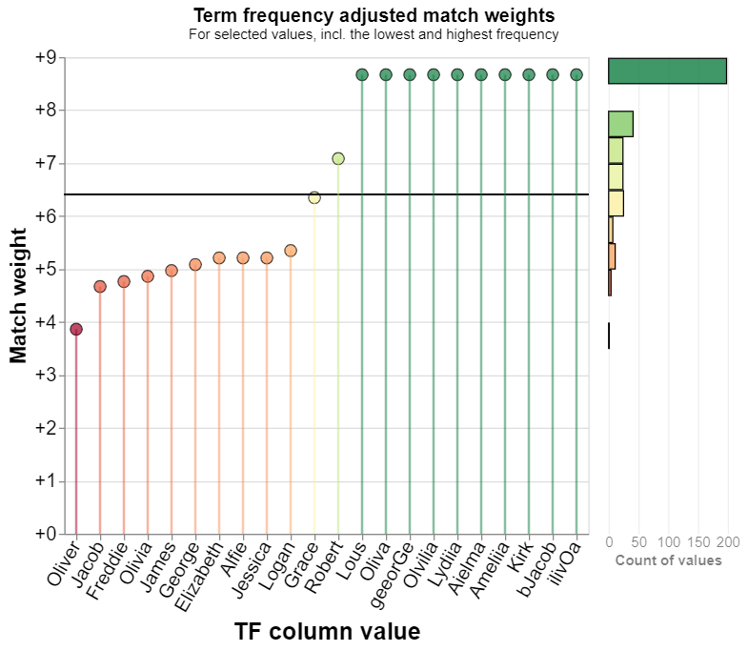
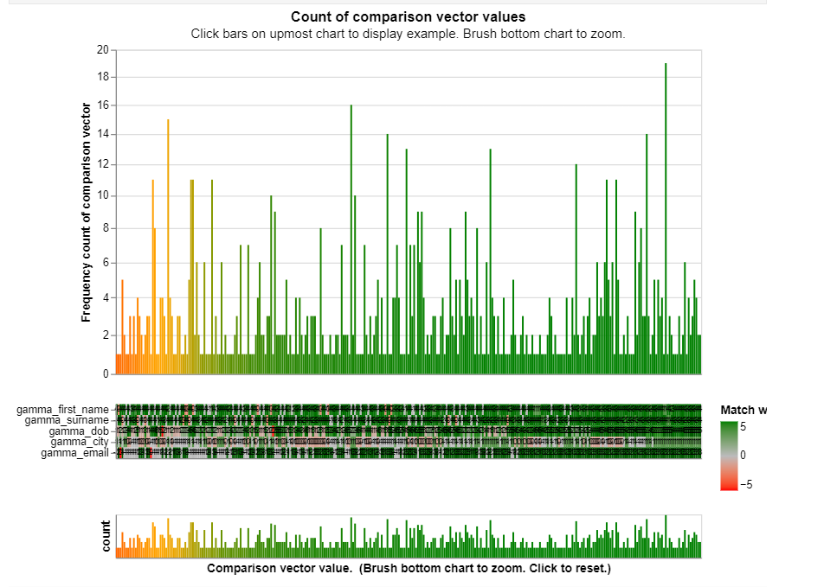
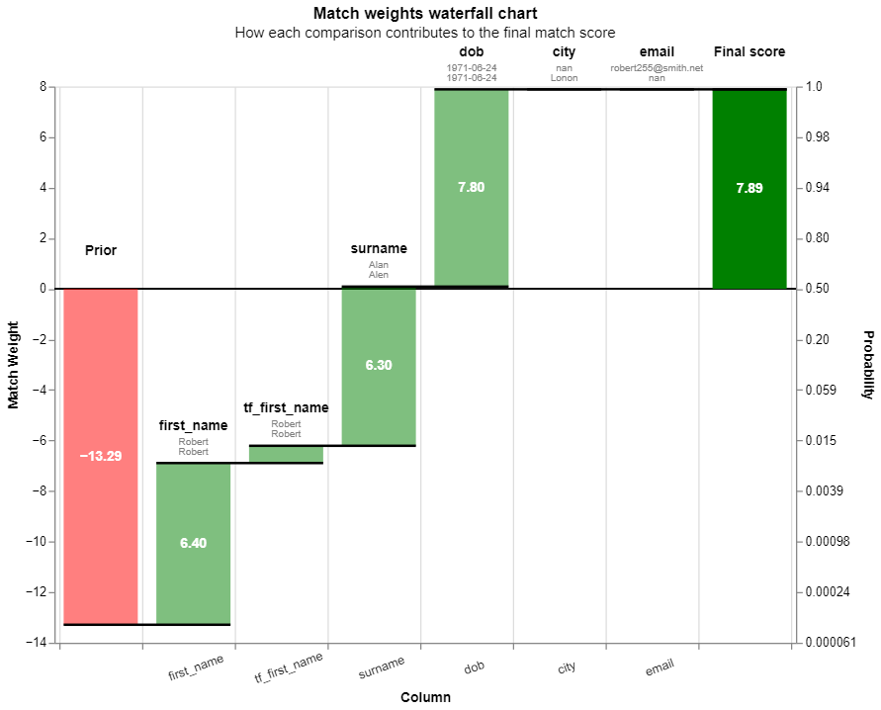
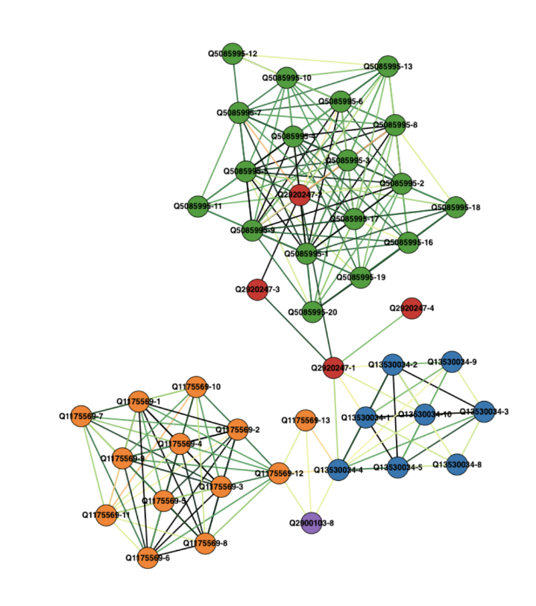
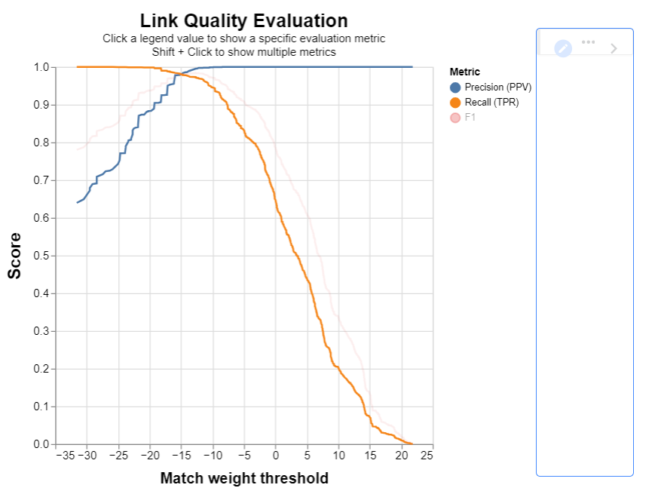
Reporting

Slide 29
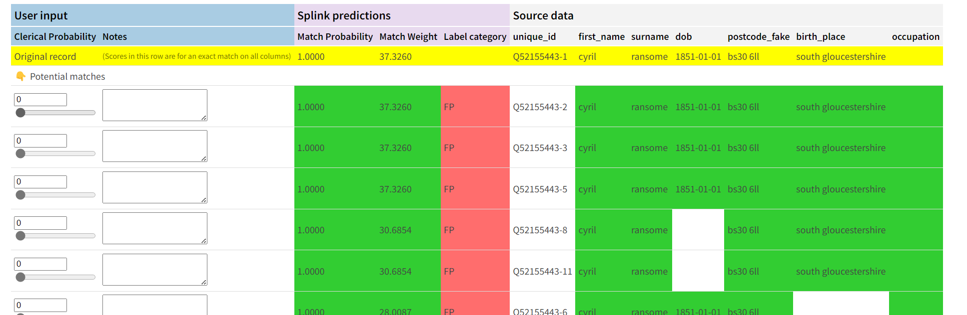
Other considerations
Matches are only estimates. We might want to confirm/reject these.
Always/Never match lists
Splink labelling tool - Splink Clerical Labelling Tool (robinlinacre.com)

Slide 30
Other considerations
Cluster output: is a pandas data frame
Poor performance for larger datasets (not MPP)
Can export to parquet instead

Slide 31
Environment Setup

Slide 32
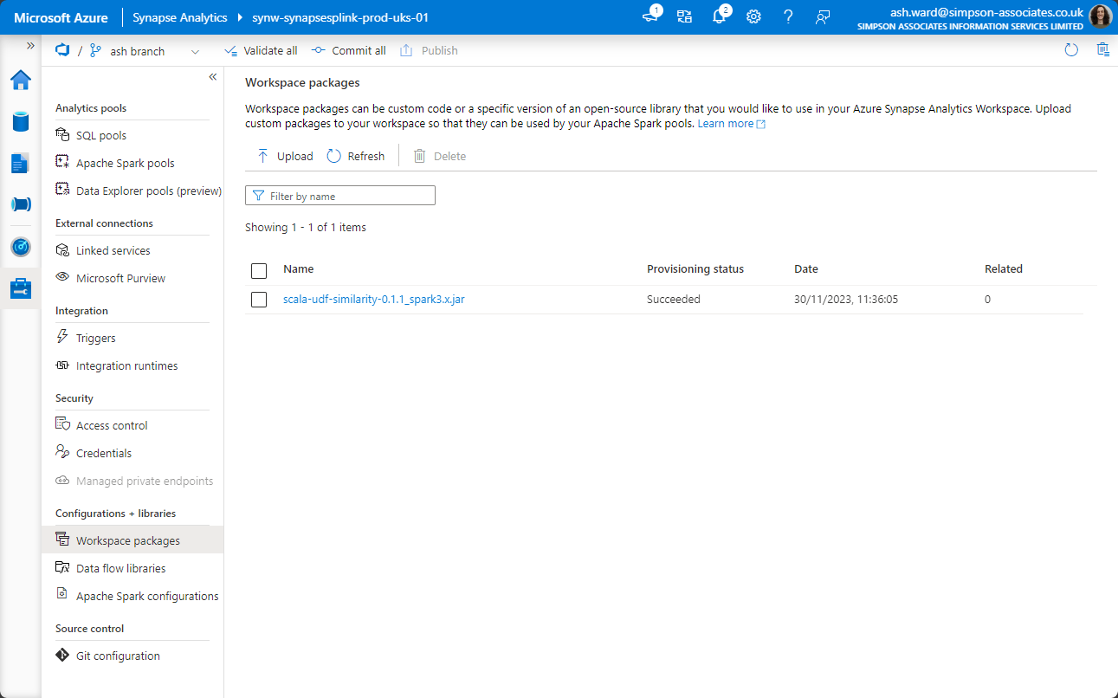
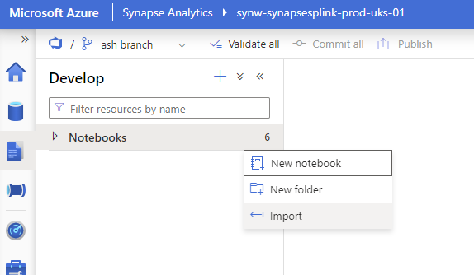
Setup & Prerequisites
Download of jar file for some of the comparison functions.
Create/use existing spark pool.
Ensure the jar file is assigned to the required spark pool.
Data should be loaded into a data frame (unless using a built-in dataset).
Splink only accepts column names which contain only lowercase letters and underscores.
Create/use existing spark pool.
Import a notebook if using one from this presentation.

Slide 33
Summary

Slide 34
Useful Links
Splink documentation
https://moj-analytical-services.github.io/splink/index.html
Splink github
https://github.com/moj-analytical-services/splink
Robin Linacre’s blog (splink theory)
https://www.robinlinacre.com/probabilistic_linkage/
Building a Single Customer View Using Open-Source Tools and Databricks by Robert Constable
https://towardsdatascience.com/building-a-single-customer-view-using-open-source-tools-and-databricks-ecc7d020ef4f
Jar File for comparisons
https://github.com/moj-analytical-services/splink_scalaudfs/tree/main/jars

